Slide 1

Computational Biology, Genetics and Epigenetics to Understand Disease Etiologies and Improve Precision Medicine
Dr. Shicheng Guo
Center for Precision Medicine Research
Marshfield Clinic Research Institute
15/05/2019
Notes:
Hi Everyone, Good Afternoon. Please first let me say thank to give me an opportunity to share the works what I have done in the past 10 years since my PhD training. This Aim of this presentation is to let know what I have done. What I am interested. What project I have charged or participated and played important roles in data analysis and manuscript preparation. It is not a easy job for me to give a comprehensive and detailed explanation for all the methods and conceptions. So when you listen to this presentation, try to capture the big pictures, try to capture the stories.

Slide 2
Outline
Human complex diseases and precision medicine
Identification of genetic variation for human complex diseases
Linkage analysis to identify acute myeloid leukemia (AML) genes
Compound heterozygote analysis to identify hemochromatosis genes
Identification of epigenetic biomarkers for human complex diseases
DNA biomarkers for Non-small cell lung cancer
Serum DNA methylation based early biomarkers for HBV-Liver Cancer
Urine DNA methylation biomarker for bladder cancer
Tissue-of-origin mapping for cfDNA fragment in the blood
Plans to obtain external funding to support my research
Contribution of Genetics variations in Epigenetics factors to human diseases (CIBM)
Cell-free DNA methylation based Pan-cancer early screening
Notes:
Automatic medicine

Slide 3
Shicheng Guo
2009-2015 Ph.D. School of Life Sciences, Fudan University, Shanghai, CN
2013-2015 Visiting student, University of Texas Health Science Center at Houston
2015-2017 Postdoctoral Fellow, Department of Bioengineering, UCSD
2017-2019 Postdoctoral Fellow, Center for Precision Medicine Research, MCRI
53 peer-view papers, 2 granted patents
Guo, S., et al. (2019). Blood 133(17): 1888-1898.
Guo, S., et al. (2017). Nature Genetics 49(4): 635-642.
Guo, S., et al. (2017). Modern Rheumatology 27(3): 441-447.
Guo, S., et al. (2016). The Journal of rheumatology 7: 3.
Guo, S., et al. (2015). Clinical Epigenetics 7(1): 3.
Guo, S., et al. (2014). Clinical Epigenetics 6(1): 5.
Guo, S., et al. (2014). Cancer Medicine 3: 3
2019, Semi-Finalists, AACC’s Disruptive Technology Award, MethylTitan, based on Nature Genetics 2017.
2018, Computation and Informatics in Biology and Medicine, NLM
2014, First Place Poster, 17th Annual Human and Molecular Genetics Symposium, GSBS, Houston, TX

Slide 4
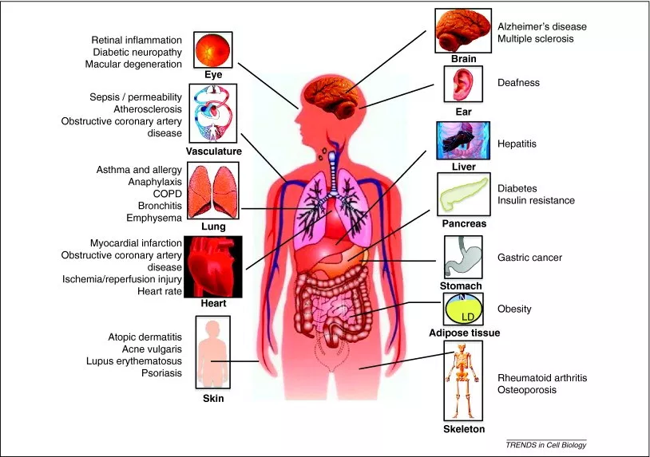
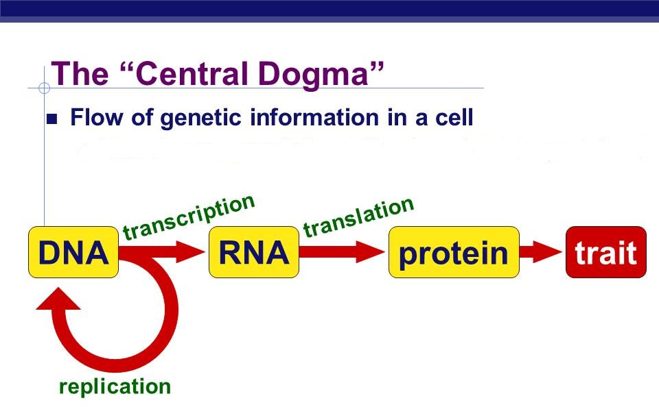
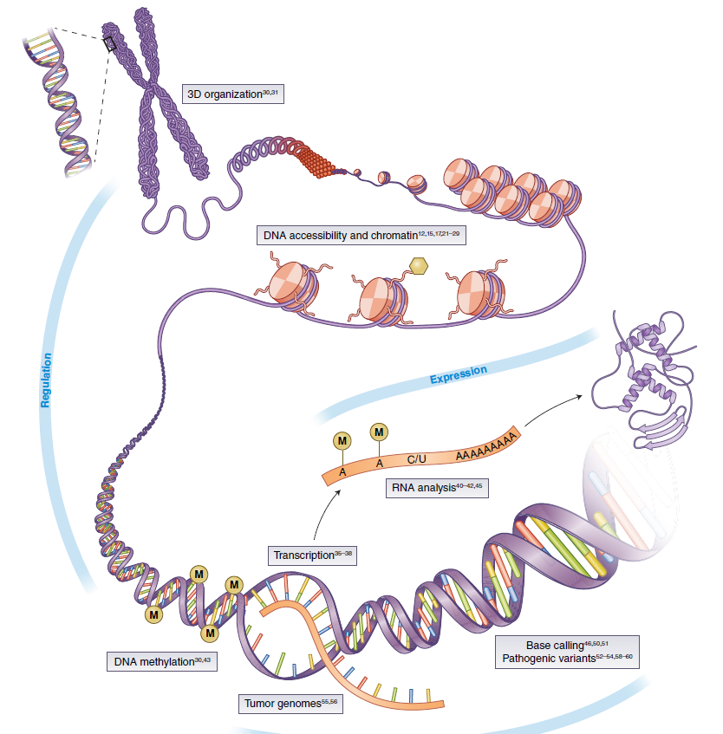
Macro and Micro View of Human Diseases in 21 Century
DNA/RNA/Protein Modification
~ 12,420 total diseases (WHO, 2011)
~ 80 different types of autoimmune diseases
~ 100 different types of human cancers
~ 7,000 rare diseases
Notes:
Let’s check what’s our understanding to disease now. We, human have almost 12 thousand disease including 80 autoimmune diseases, 100 cancers and more than 7,000 rare diseases. Except these, we don’t know how many infectious diseases. However, for all these diseases, we always can find the disease ideologies from tissues or cells. For example, DNA, RNA, protein or its related modifications, such as DNA methylation, miRNA or histone modifications.

Slide 5
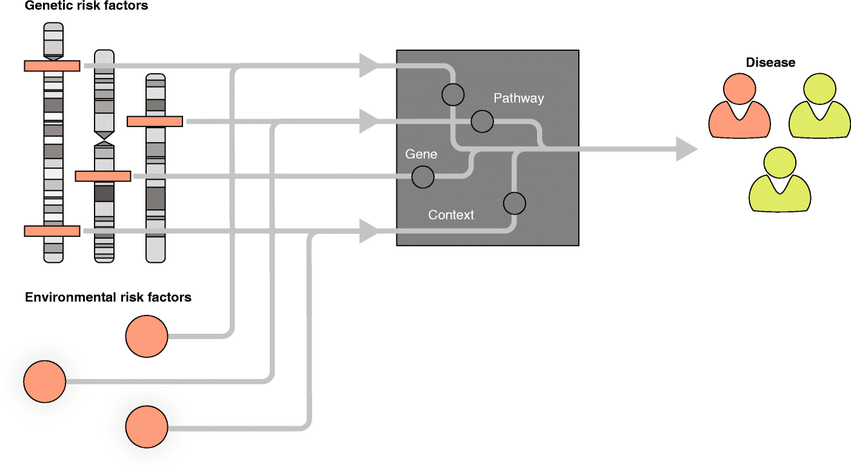
Computational Frame for Disease Etiology and Pathology
Genetic risk factors
EHR
Clinical Phenotypes
Weeks
Years
ICD9
Lab Test
Network
Pathological phenotypes
Image phenotypes
Environmental risk factors
Electroencephalography (EEG)
Electrocardiography (ECG)
Positron Emission Tomography (PET)
Magnetic Resonance Imaging (MRI)
X-Ray radiography image
Ultrasonography image
Epigenetics risk factors
Lifestyle/family history risk factors
Notes:
In order to full understand the disease, the best computational/informatics approach is to integrate all the information for the patients, such as genetic risk factor, environment risk factors, epigenetics risk factors, lifestyle and family history. Meanwhile, we have EHR information, including all kinds of image data, EEG, ECG, PET, ICD9/ICD10.

Slide 6

What is Precision Medicine?
Precision Medicine
Personalized Medicine
Smart Medicine
Smart Hospital
Automatic Medicine Approach to Support Physicians
Notes:
As a bioinformatician, it is hard for me to understand precision medicine since what we have done in the past 1000 years all of them is for ‘precision medicine’. And I cannot tell the difference between precision medicine, personalized medicine, smart medicine, smart hospital. In prefer to use “automatic medicine” to describe my works which just like “Amazon Go”, the patients call here, draw the blood, DNA will be sequenced, cell-free DNA methylation will be measured, AFP, HBV will be detected and then the system will tell you are 90% having too much alcohol, 70% have liver damage.

Slide 7
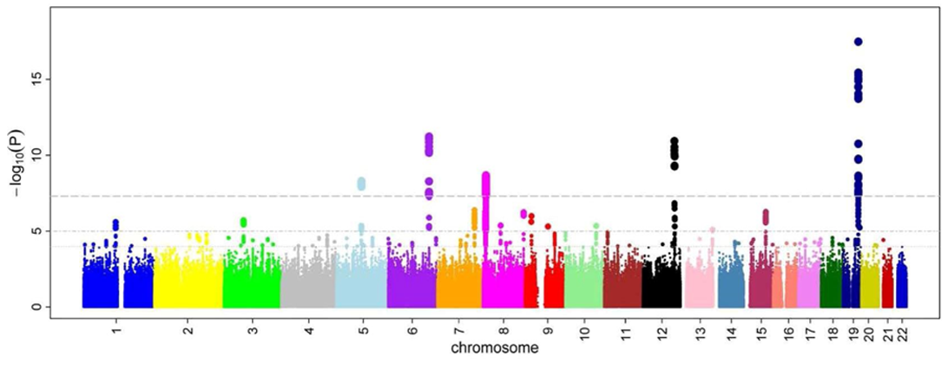
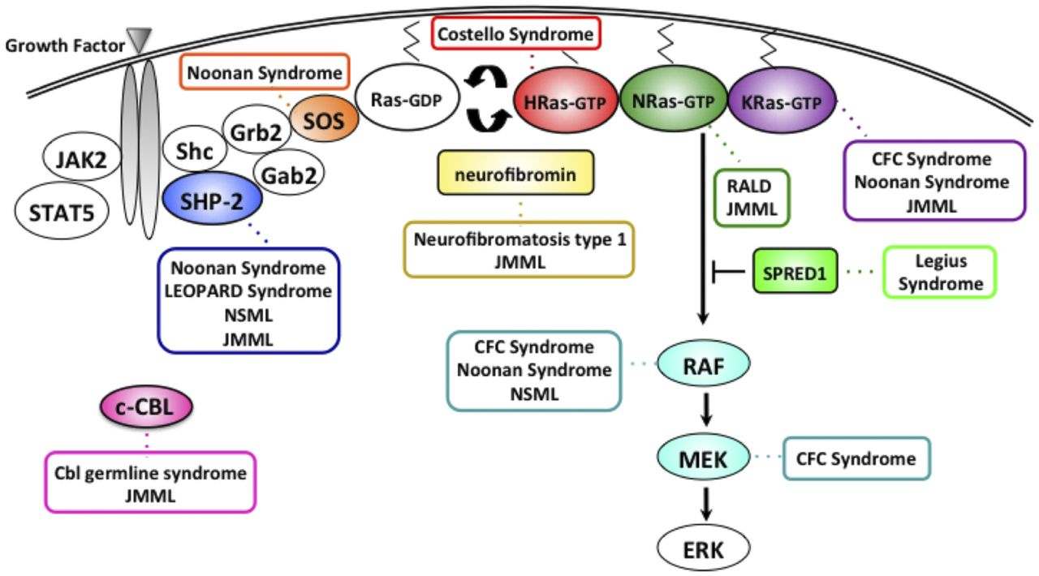
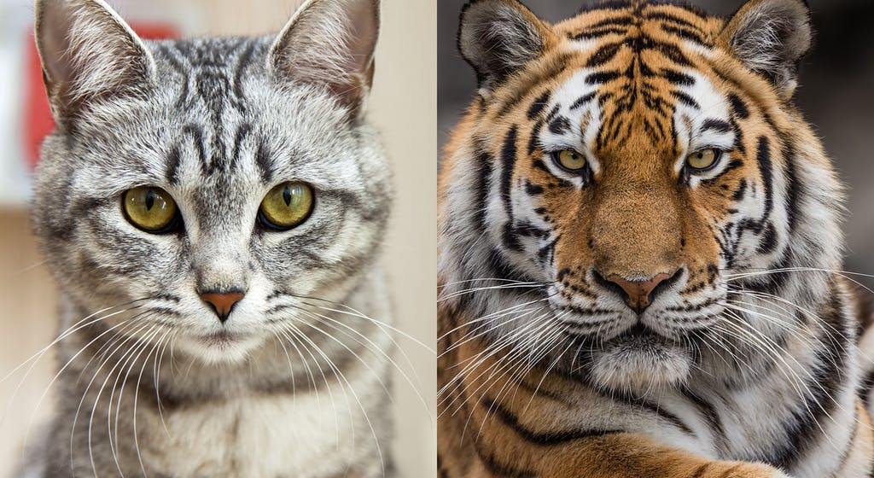
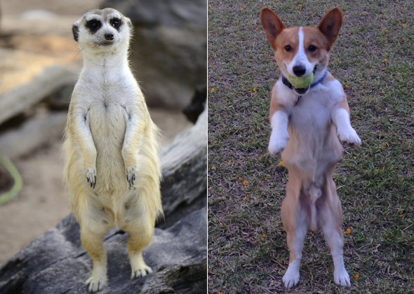
How to achieve Precision Medicine?
1. Direct way: to understand each diseases with deep knowledge
2. indirect way: it looks we are similar (Data Driven)
Notes:
Another question is How to achieve Precision Medicine? The first way I think is knowledge driven in while we build more and more knowledge to each diseases. We identify all the disease genes and pathways and then we understand how the diseases were happened. The second way is I don’t care about we kinds of disease you are, I just know you are quite similar with another known diseases. I know how to therapy the know disease and you should be cured in same way. This way is also called Data Driven way. Actually, all the research works what I have conducted are belong to the first one, we selected a diseases, find case and control and find the difference and then find the disease genes.

Slide 8
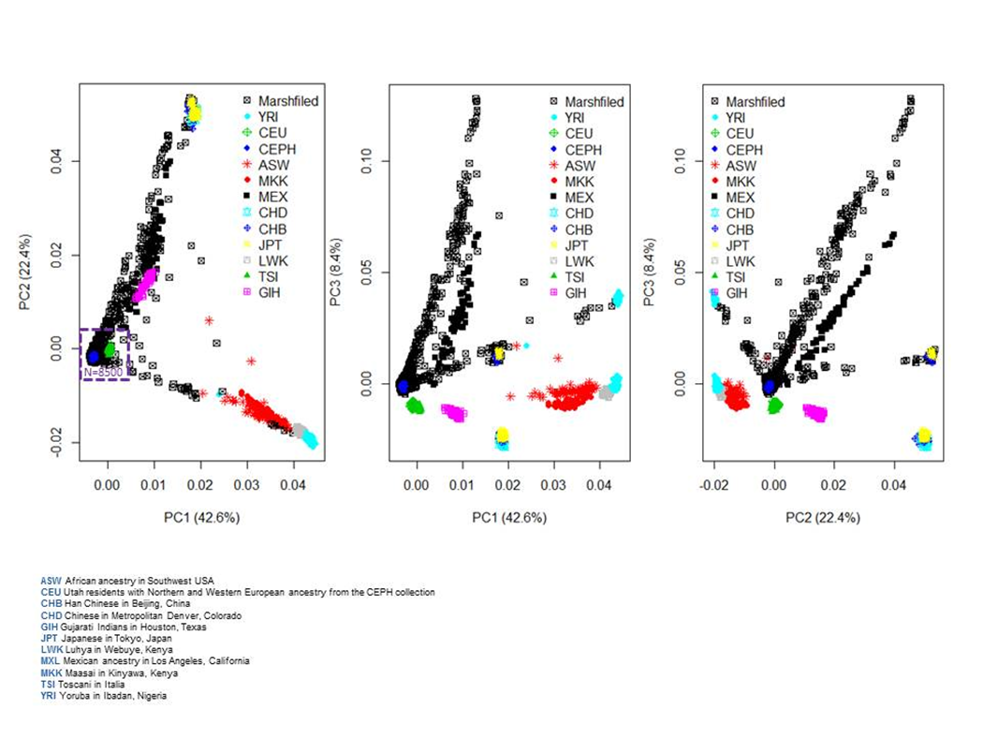

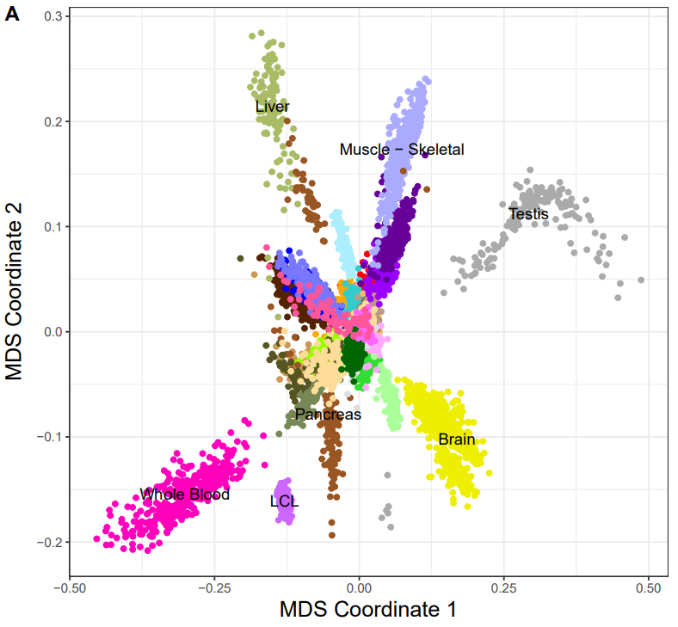
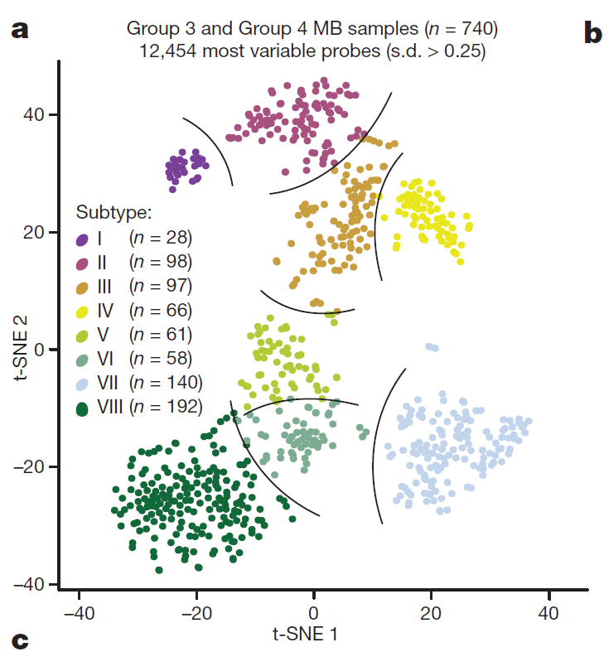
Individual, tissue and subtype identification with genomic data
CoreExome Beadchip Genome-wide RNA-Seq data
Genome-wide DNA methylation data
Asian
Brain cancer
European
African
Brain
Unpublished data, Guo, Schrodi, 2019
Modified, Nature, 2017; 550 (7675): 204
Modified, Nature, 2017; 547 (7663): 314
Data driven precision medicine: if they were same, data will show us
Notes:
In the large genomic data time, we can do lots of things without clinical or demographic information. For example, we can apply genetic data to distinguish the race of the individual or estimate the proportion for each race components. With RNA-seq data, we can distinguish different human tissues. With DNA methylation data, we can tell the subtypes of brain cancer samples. Different genetic component can be applied for different application.

Slide 9
Outline
Human Complex Diseases and Precision Medicine
Identification of genetic variation for human complex diseases
Linkage analysis to identify acute myeloid leukemia (AML) genes (EJHG, 2015)
Compound heterozygote analysis to identify hemochromatosis genes (Blood, 2019)
Identification of Epigenetic biomarkers for human complex diseases
DNA biomarkers for Non-small cell lung cancer (Clinical Epigenetics, 2015)
Serum DNA methylation based early biomarkers for HBV-HCC (Clinical Epigenetics, 2017)
Urine DNA methylation biomarker fors bladder cancer (PloS One, 2015)
Tissue-of-origin mapping for cfDNA fragment in the blood (Nature Genetics, 2017)
Plans to Obtain External Funding to Support my Research
Contribution of Genetics variations in Epigenetics factors to human diseases (CIBM)
Cell-free DNA methylation based Pan-cancer early screening in PMRP cohort (RO1)
Notes:
Automatic medicine

Slide 10
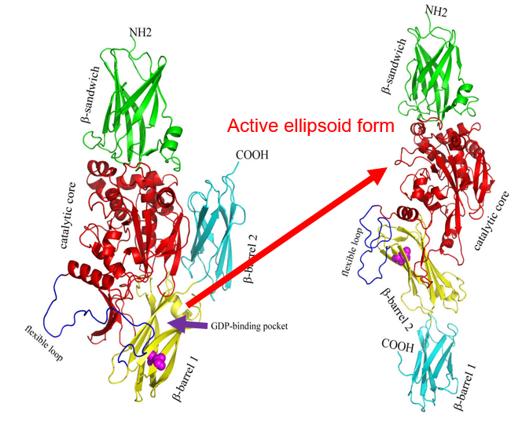
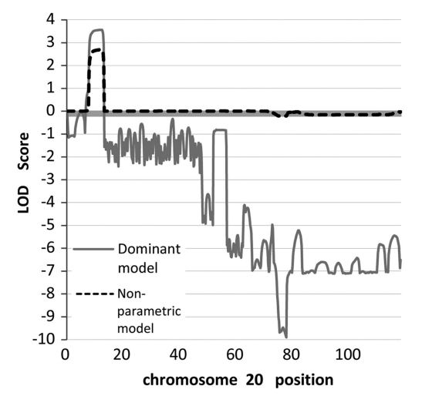
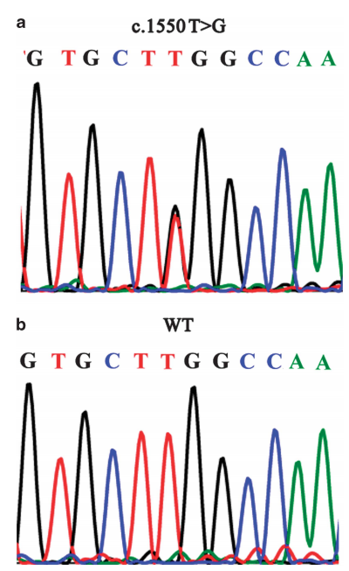
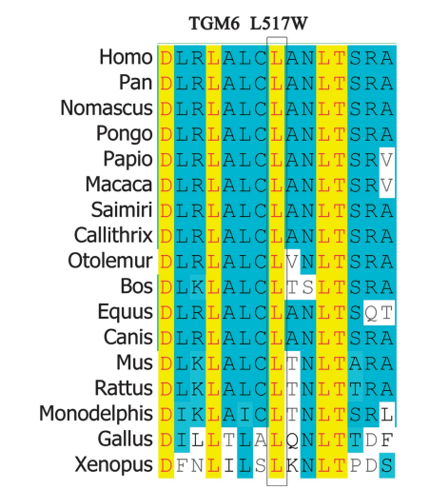
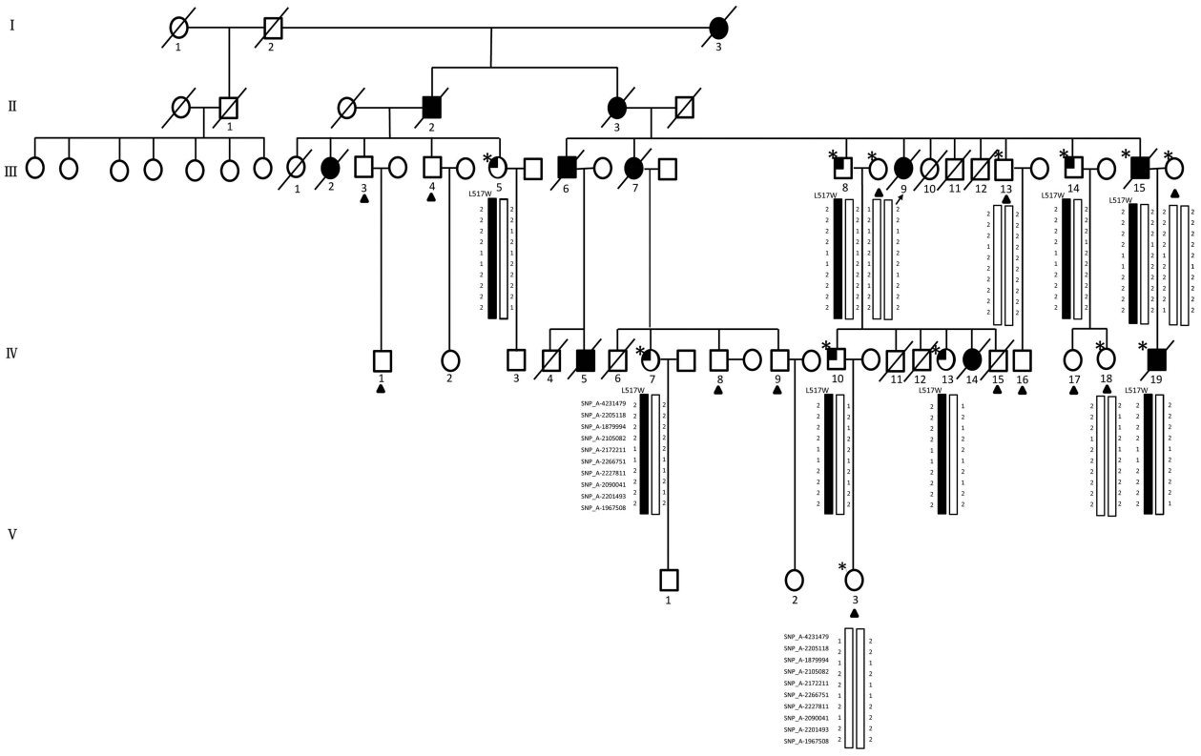
Linkage analysis to identify acute myeloid leukemia (AML) genes: TGM6
20p13, P=5x10⁻⁵
13 Affymetrix 500K Arrays
LOD: Logarithm of ODds
Autosomal-dominant AML family with 11 cases in four generations
Linkage analysis and targeted next-generation sequencing (NGS)
2 exonic variants (TGM6 and CENPB), 15 intronic, 15 intergenic and 4 UTR variants
TGM6(Transglutaminase-6): L517W occurred in 2 patients and 6 members at potential pre-leukaemic phase, but not in 13 unaffected individuals and 530 ethnically matched healthy controls
Mutation might make TGM6 have strong GDP-binding ability and easy to transfer to active form.
..,Guo S et al.. European Journal of Human Genetics (2015) 23, 218–223
Notes:
As I mentioned before, I didn’t have enough time to show too much details. In the first example, we come cross an acute myeloid leukemia family.

Slide 11
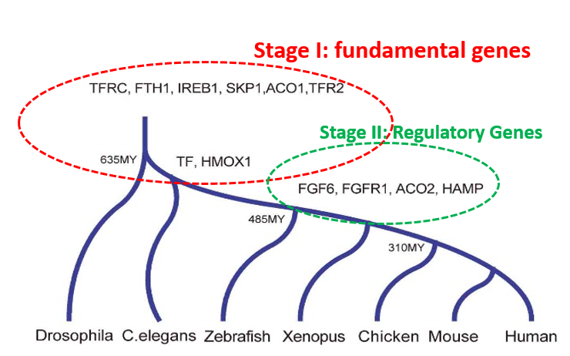
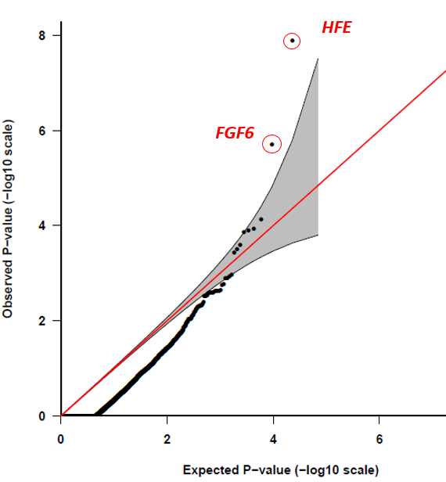
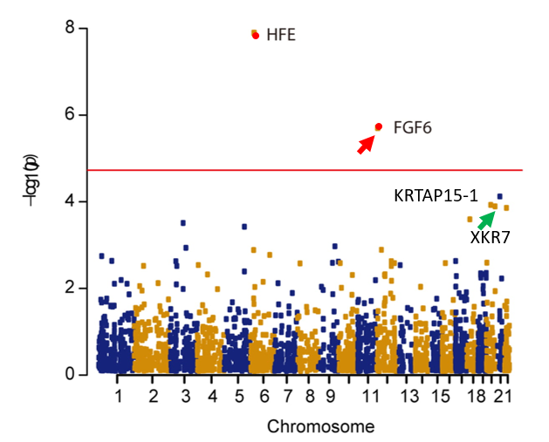
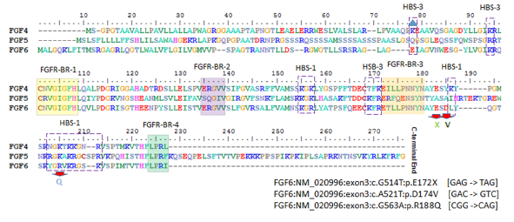
Gene-based recessive diplotype exome scan discovers FGF6 as a iron metabolism gene
OR(FGF6)=22.8
Fibroblast Growth Factor 6
Heparin-Binding Growth Factor 6
Guo, S. et al.. Blood 133, 1888-1898 (2019).
Notes:
Another story is what we have done recently. We proposed a new statistical method called “Gene-based recessive diplotype exome scan” to identify compound heterozygote loss-of-function disease variants. We apply this method in hemochromatosis selected from PMRP samples. In PMRP dataset, we identified 18 hemochromatosis and 6896 controls. With found in the association study, the most significant genes is a known iron metabolism genes: HFE while the second is quite interesting called “FGF6”. Qq-plot shown FGF6 is significant deviate from expected P-values. FGF6 called Fibroblast Growth Factor 6 and also have another name: Heparin-binding growth factor 6. With compare genomic method, we found iron metabolism genes have two wave evolutions. The stage I genes are belong to fundmental iron metabolism genes. FGF6 is as same as other iron regulatory genes such as ACO2, HAMP. We predicted functional domains of FGF6 and find the 3 variants are located in very important functional domain regions.

Slide 12
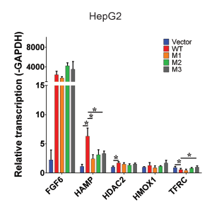
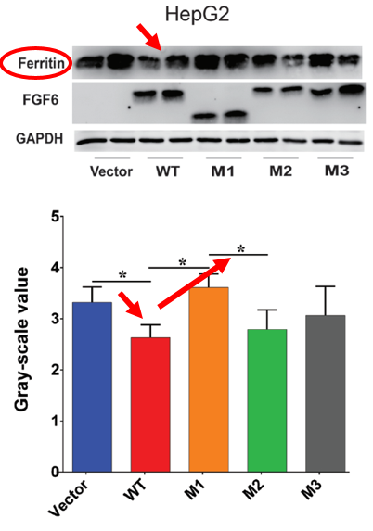
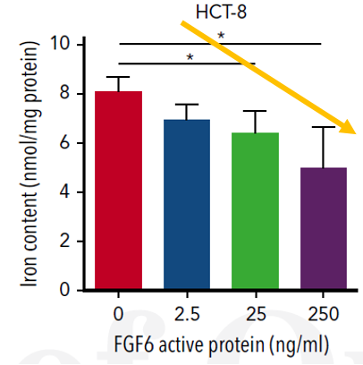
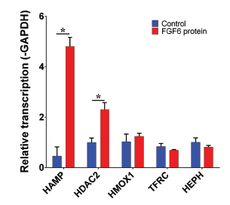
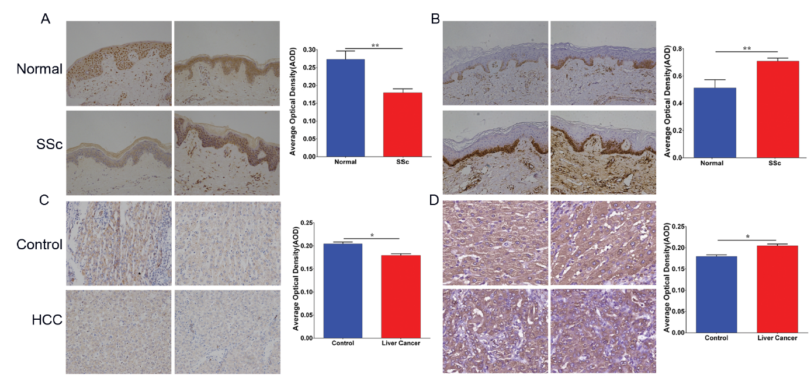
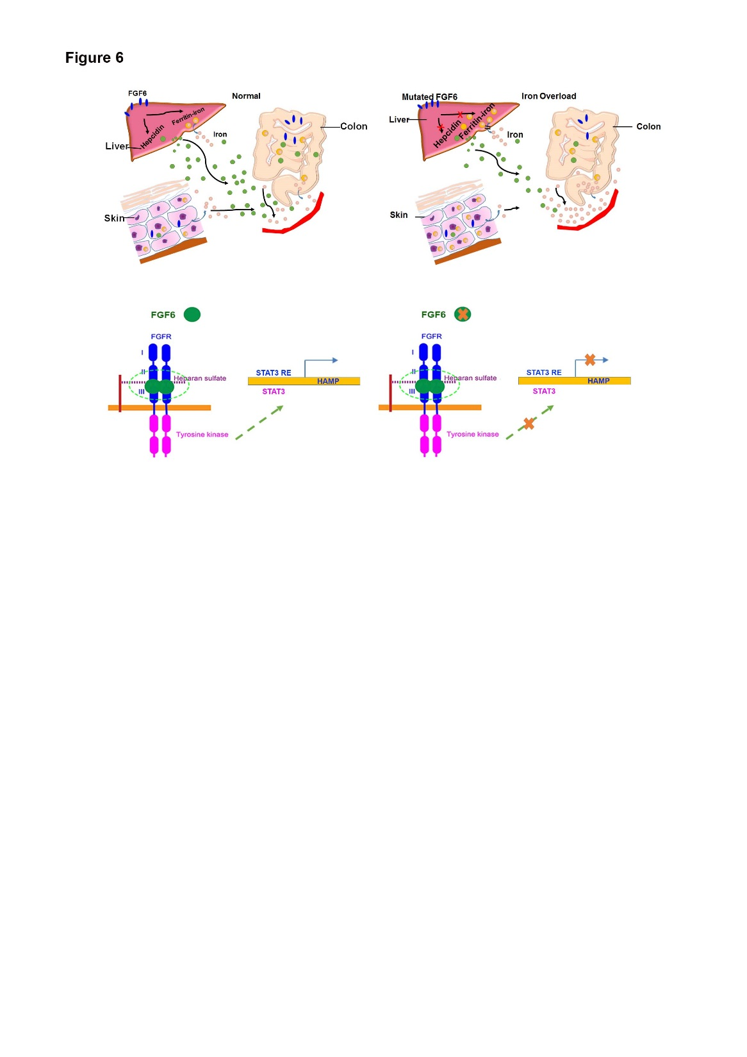
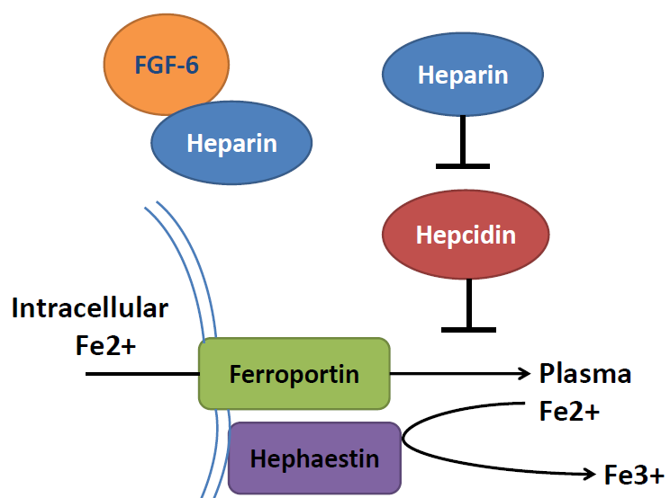
Molecular, Cellular and Immunohistochemistry to Validate FGF6 Functions
CTR
SSc
CTR
Ferrous form
HCC
Ferric form
Guo, S. et al.. Blood 133, 1888-1898 (2019).
Notes:
We then designed several molecular and cellular experiments to validate the FGF6 functions. First, we treat the cell with FGF6 active protein and we found the iron concentration in the cells are significantly reduced as the increasing of FGF6 protein levels. And when we find HAMP gene expression level was significantly increased when we treat cells with FGF6 protein while other iron metabolism cells didn’t have significant changes. We then find if we treat the cells with mutated FGF6, we find the HAMP gene expression cannot be increased. Western blot also confirm that functional FGF6 can decrease iron level In the cells while mutated FGF6 don’t have such function. We also checked some other diseases such as liver cancer and inflammation, and we found in these situations, we find FGF6 have low gene expression and high iron deposition in the cells. Therefore, all the result demonstrate FGF6 play important roles in iron regulation through HAMP. Our findings provide a new insight for the pathology of hemochromatosis and iron metabolism.

Slide 13
Outline
Human Complex Diseases and Precision Medicine
Identification of genetic variation for human complex diseases
Linkage analysis to identify acute myeloid leukemia (AML) genes (EJHG, 2015)
Compound heterozygote analysis to identify hemochromatosis genes (Blood, 2019)
Identification of Epigenetic biomarkers for human complex diseases
DNA biomarkers for Non-small cell lung cancer (Clinical Epigenetics, 2015)
Blood DNA methylation early biomarkers for HBV-HCC (Clinical Epigenetics, 2017)
Urine DNA methylation biomarker for bladder cancer (PloS One, 2015)
Tissue-of-origin mapping for cfDNA fragment in the blood (Nature Genetics, 2017)
Plans to Obtain External Funding to Support my Research
Contribution of Genetics variations in Epigenetics factors to human diseases (CIBM)
Cell-free DNA methylation based Pan-cancer early screening in PMRP cohort (RO1)
Notes:
Automatic medicine

Slide 14
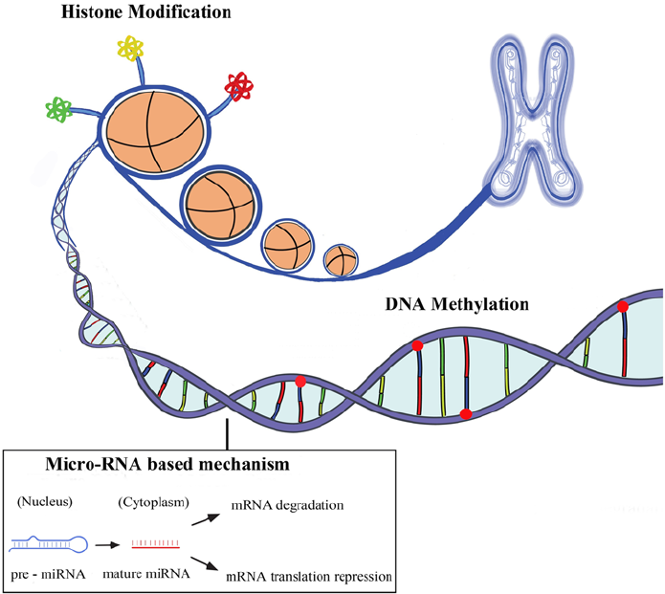
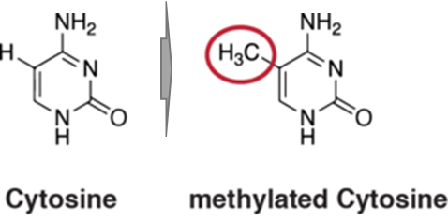
Human Genome and modification systems (Epigenetics)
DNA modification
DNA methylation
DNA hydroxymethylation
Histone modification
H3K4me1, H3K4me3
H3K27ac, H3K9ac
ncRNA system
miRNA
lncRNA
circRNA
piRNA
methyl group
Allis, Nature Review Genetics, 2016
Notes:
Our human genome is composed of A,T,C,G 4 different bases. However, human genome is not linear form.

Slide 15

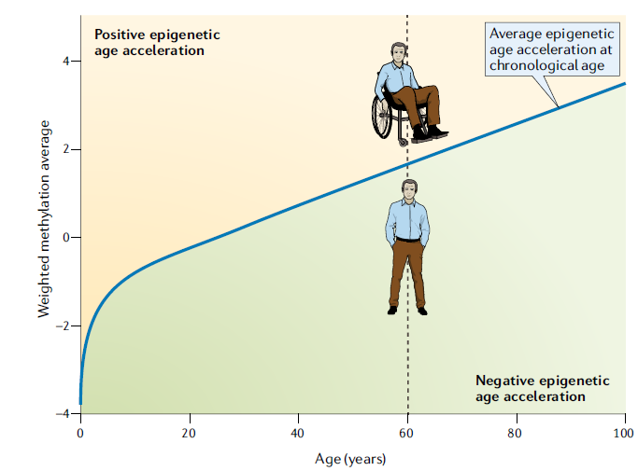
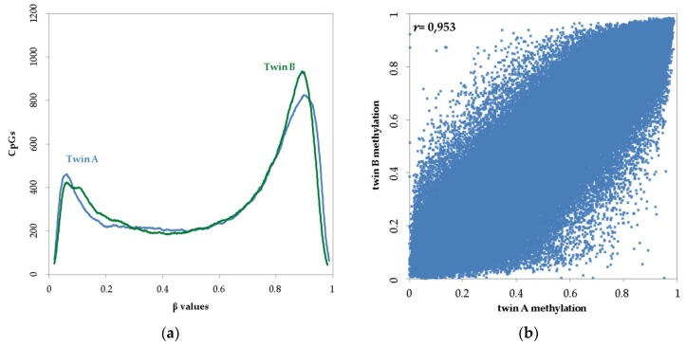
The Power of DNA methylation a biomarker
DNA ~100%
R²=0.91
DNA methylation-based age and age acceleration
Horvath, Nature Review Genetics, 2018
Guo, unpublished data
Kaminsky, Nature Genetics, 2009
Notes:
Almost all diseases showed abnormal methylation change
Aging can be highly predicted by methylation clock
High sensitivity: single molecular with PCR
Stable in vitro without degradation
High tissue and status specificity
Change earlier than mRNA and protein
Easy to be assembled to a multi-disease panel

Slide 16
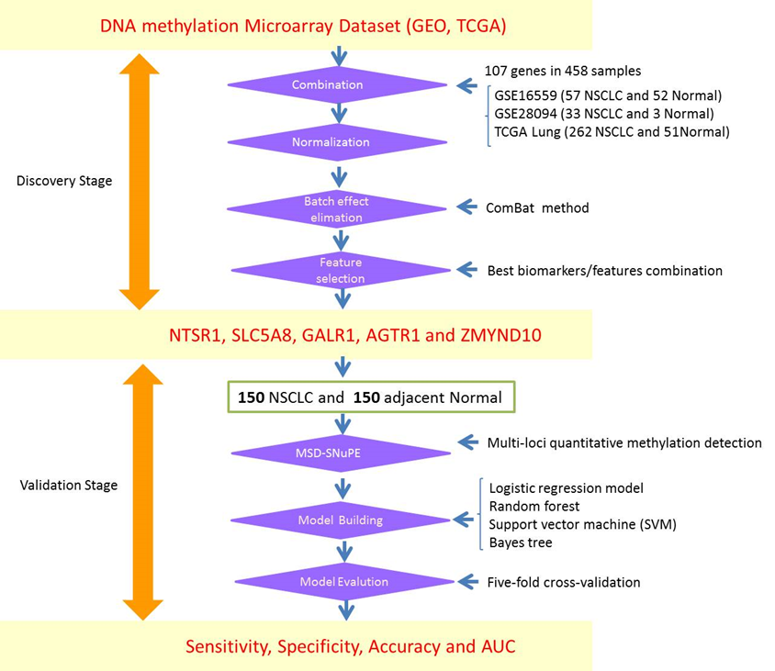
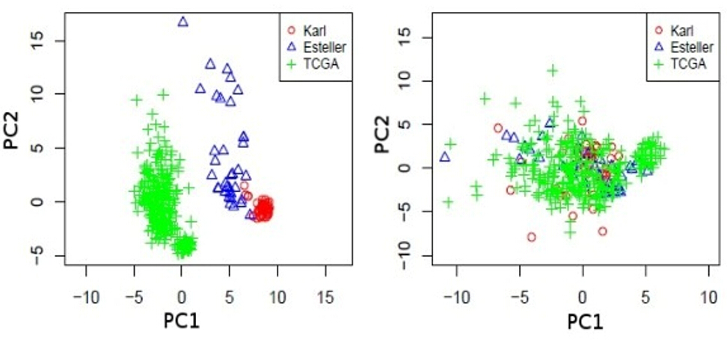
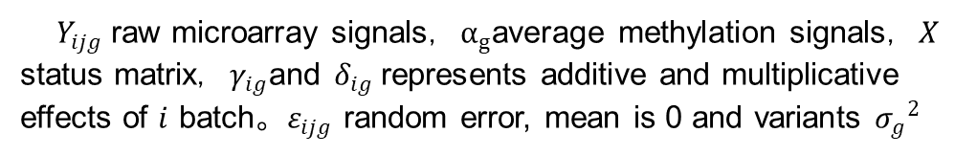
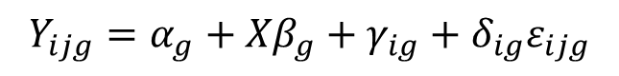
Identification and validation of the methylation biomarkers of non-small cell lung cancer (NSCLC)
$$Y_{ijg}=α_{g}+{Xβ}_{g}+γ_{ig}+δ_{ig}ε_{ijg}$$
$Y_{ijg}$ raw microarray signals，$α_{g}$average methylation signals，$X$ status matrix，$γ_{ig}$and $δ_{ig}$represents additive and multiplicative effects of $i$ batch。$ε_{ijg}$ random error, mean is 0 and variants ${σ_{g}}^{2}$
1
2
3
Guo, S et al (2015). Clin Epigenetics 7: 3

Slide 17
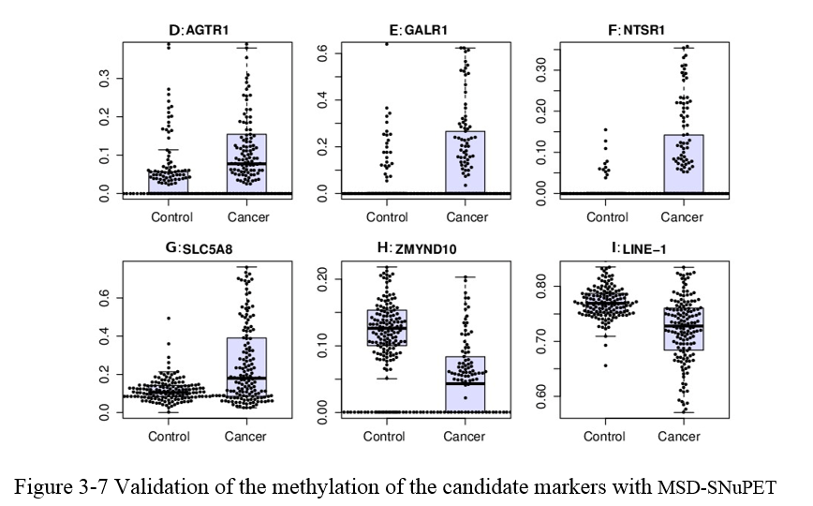
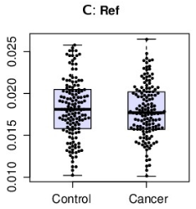
Methylation Status Determined-Single Nucleotide Primer Extension Technique (MSD-SNuPET) based Cancer Prediction
 | Train |  |  | Test
 | SEN | SPE | ACC | SEN | SPE | ACC
Logistic Reg | 0.79 | 0.99 | 0.89 | 0.78 | 0.97 | 0.87
SVM | 0.90 | 0.98 | 0.94 | 0.86 | 0.94 | 0.90
Random Forest | 0.93 | 0.93 | 0.93 | 0.89 | 0.89 | 0.89
Bayes Tree | 0.91 | 0.98 | 0.94 | 0.86 | 0.96 | 0.91
Neural Network | 0.80 | 0.90 | 0.88 | 0.75 | 0.89 | 0.80
KNN (K=2) | 0.60 | 0.95 | 0.96 | 0.71 | 0.92 | 0.79
FPCA | 0.84 | 0.96 | 0.90 | 0.82 | 0.88 | 0.84
P=0.285
Methylation Level (beta)
 | NSCLC | CTR | Sen | Spe | AUC
AGTR1 | 12.88% | 4.48% | 59.73% | 79.59% | 0.71
GALR1 | 18.31% | 2.91% | 46.98% | 85.03% | 0.67
NTSR1 | 9.37% | 0.56% | 44.30% | 94.56% | 0.70
SLC5A8 | 25.59% | 11.66% | 52.35% | 88.44% | 0.67
ZMYND10 | 6.95% | 12.82% | 73.15% | 92.52% | 0.80
Summary:
Data integration of DNA methylation is helpful.
Batch effect is strong between different platforms.
MSD-SNuPET could be applied for biomarker identification
Bayes Tree and Random Forest are powerful for prediction

Slide 18
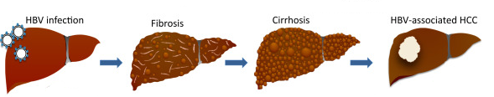
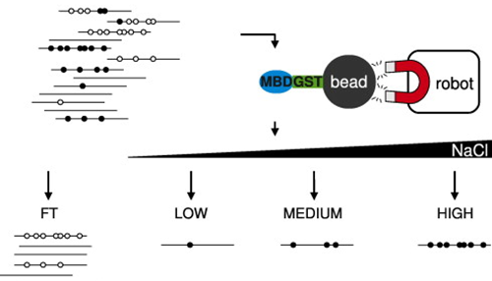
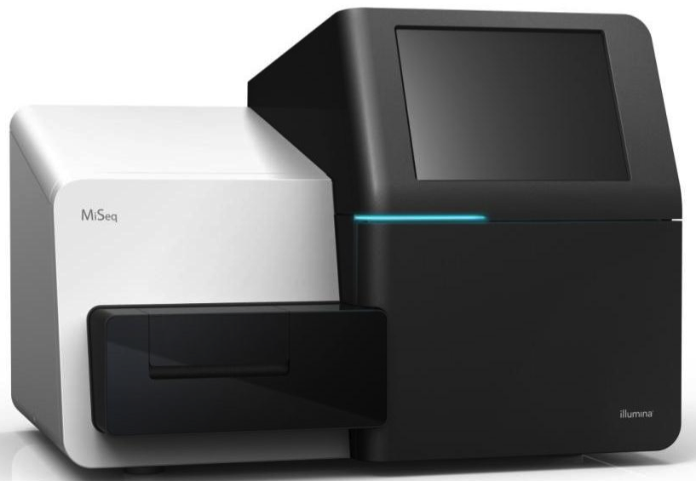
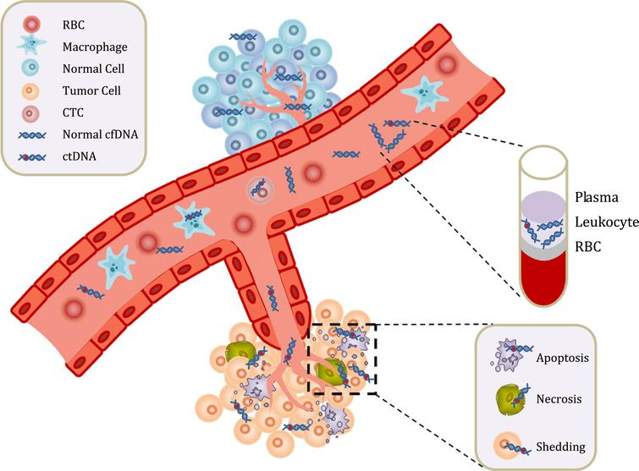
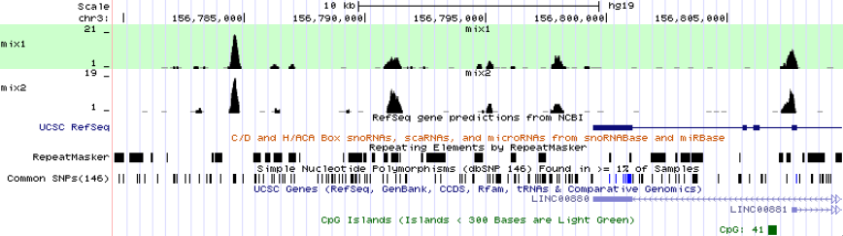
Epigenome analysis of serum cell-free circulating DNA in progression of HBV-related Hepatocellular carcinoma
Aim: to identify early blood biomarkers for HBV-induced Hepatocellular carcinoma
Pooled 30 healthy control
Pooled 30 HBV-related hepatitis
HBV infection
Fibrosis
Cirrhosis
HBV-associated HCC
Pooled 30 HBV-related liver cirrhosis
Pooled 30 HBV-related hepatocellular
Process of Hepatitis B Virus-Associated Hepatocellular Carcinoma

Slide 19
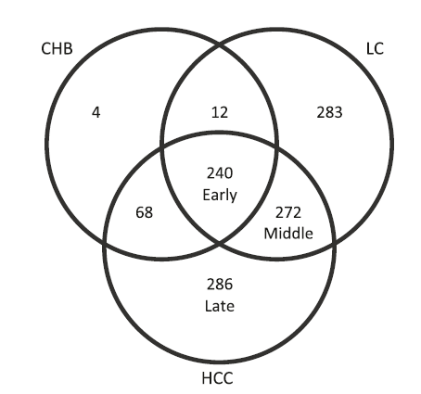
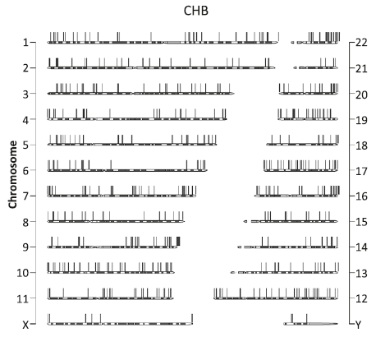
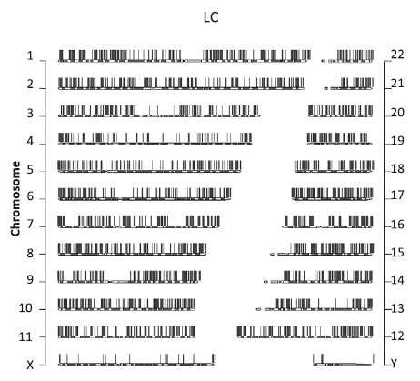
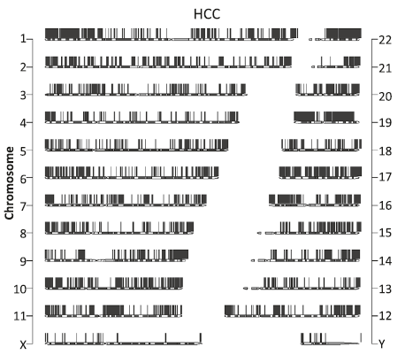
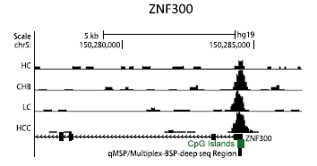
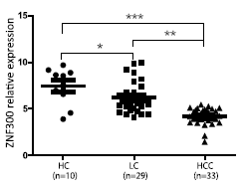
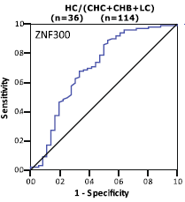
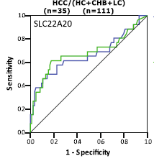

Epigenome analysis of serum cell-free circulating DNA in progression of HBV-related Hepatocellular carcinoma
HBV-related hepatitis HBV-related liver cirrhosis HBV-related HCC
AUC=0.7
AUC=0.68
AUC=0.76
Data Availability : GSE54961
Zhao Y#,…, Guo S# et al. Clin Epigenetics 2014;6(1):30

Slide 20




Methylcap-seq reveals novel DNA methylation markers for the diagnosis and recurrence prediction of bladder cancer
Aim: to Identify urine DNA methylation based bladder cancer diagnosis biomarkers
Mayo Clinic Website, 2019
Zhao, Y#, S. Guo#, J. Sun# et al. (2012). PLoS One 7(4): e35175

Slide 21
Application of DNA methylation Panel in Diagnosis and Surgery Evaluation
48 suspected bladder cancer patients
26 Confirmed BCC
Cystoscopy
Methylation Panel
32 BCC
16 non-BCC
21 Methylation Positive Patients
Methylation Panel
Bladder Cancer Remove Surgery
25 BCC
SEN=78.1%
14 non-BCC
SPE=87.5%
19 Negative
2 Positive
P<0.0001
Surgery Success Ratio：91%
24 month Follow-up to 2 individuals
Lost Follow-Up
1/2 diagnosis as BCC
Zhao, Y#, S. Guo#, J. Sun# et al. (2012). PLoS One 7(4): e35175
Notes:
We also evaluated our panel in another two scenarios. First one, we try to compare the difference between Cystoscopy and methylation panel. We recruited 48 suspected bladder cancer patients. With Cystocscopy test, we found 32 of them are BCC and 16 non-BCC patients. We tried methylation panel test to these 48 individuals, we found 25 of 32 BBC patients were BCC positive, the sensitivity is 78.1% while 14 of 16 non-BCC patients were negative, the specificity were 87.5%. We followed these 2 non-BCC individuals who have positive methylation signals and interestingly, 1 of them were diagnosis as BCC, indicating methylation signals could be taken as risk warning for BCC patients.
In another scenario, we apply DNA methylation to assess surgery success ratio. We recruited 26 confirmed BCC patients who are going to take bladder cancer remove surgery. We find 21 of 26 patients have positive methylation signal. We also detected methylation signal after the surgery, we find the 19 of them are shown methylation negative, indicating the surgery success ratio is about 91%. We want to know what will happened to another two positive

Slide 22




Methylation Haplotype and Methylation Haplotype Load
ctDNA 10-200ng/ul Plasma
l: length of haplotype
$w_{i}=i$ or $w_{i}=i^{2}$
Methylation level and pattern of co-methylation (complexity)
S. Guo et al. 2017, Nature Genetics
Notes:
Therefore, in 2015, we start a project called “tissue-of-origin mapping” project. We know that DNA sequence in different tissues are exactly same. However, for DNA methylation, each tissue has his own profiles. Can we try to use this profiles to mapping the cfDNA fragment to its own “tissue-of-origin”. That’s what we did. As this shown, this is a 4 CpG loci DNA fragment and we can find there are several different DNA methylation pattern. However, how to recognize these different patterns? We find all the existed DNA methylation level measurement cannot 100% separate them. Therefore, we build a new index: called DNA methylation haplotype load and this index can tell the difference between all the situations.

Slide 23

Tissue clustering based on cell-free circulating DNA methylation
Endoderm Mesoderm Ectoderm
Unsupervised clustering of human tissues using the top 15% most-variable regions from WGBS
We identified numerous germ-layer-specific methylation markers
S. Guo et al. 2017, Nature Genetics
Notes:
With Unsupervised clustering we found Methylation haplotype have the ability to show the similarity between difference tissues. No only for mature tissues, We find huge number of MHL which can be used to tell the germ-layer-specific methylation biomarkers. It tell us DNA methylation haplotype load might be a good biomarkers.

Slide 24


Tissue specific hyper-methylation MHB regions show tissue specificity
MHL
S. Guo et al. 2017, Nature Genetics
Notes:
Then we want to know how well DNA methylation to separate different tissues. We collected 14 human tissues, from the genome-wide DNA methylation sequencing data, we identified most powerful tissue-specific methylation haplotype load markers, we can find the separation performance is quite good. And then we collected more samples, like normal plasma, colon cancer plasma, colon cancer tissue, normal colon tissues, whole blood and other human tissues. With cluster analysis, we can find the GII markers will be useful for colon cancer cell-free DNA fragment identification. These marker hyper-merthylated in normal colon and colon cancer while non-methylated in our tissues and blood cells. Now, suppose colon cancer DNA were related to the plasma, we can guess DNA methylation levels in colon cancer patients should higher than normal individals. And that’ exactly what we find in our result. Meanwhile, we compared our meansurement and traditional methylation measurement, we found methylation haplotype load have higher power to detect same level DNA fragment in the plasma.

Slide 25


Performance of tissue-specific MHL based tissue-of-origin mapping
Sensitivity: 87.9%
Sensitivity: 87.6%
Specificity: 90.2%
S. Guo et al. 2017, Nature Genetics
Notes:
Above this non-supervised method. We need to provided a quantitative estimation to this method. How about apply supervised method to make prediction? So we collected 75 normal plasma, 29 lung cancer and 30 colon cancer plasma. We applied the maximum likelihood method to assign the cancer types with the maximum tissue-specific signals. We train our method in 10 different solid tissues and we find the accuracy in the training datset is quite good. And then apply the method is test dataset and we find 87.9% colon cancer plasma can be assigned to colon. Similar for other two cancers. demonstrating this method could be used for “tissue-of-origin mapping”. I also found DNA methylation halotype load can be also used in tumor dna fragment estimation in the plasma.

Slide 26
Outline
Human Complex Diseases and Precision Medicine
Identification of genetic variation for human complex diseases
Linkage analysis to identify acute myeloid leukemia (AML) genes (EJHG, 2015)
Compound heterozygote analysis to identify hemochromatosis genes (Blood, 2019)
Identification of Epigenetic biomarkers for human complex diseases
DNA biomarkers for Non-small cell lung cancer (Clinical Epigenetics, 2015)
Blood DNA methylation early biomarkers for HBV-HCC (Clinical Epigenetics, 2017)
Urine DNA methylation biomarker for bladder cancer (PloS One, 2015)
Tissue-of-origin mapping for cfDNA fragment in the blood (Nature Genetics, 2017)
Plans to Obtain External Funding to Support my Research
Contribution of Genetics variations in Epigenetics factors to human diseases (CIBM)
Cell-free DNA methylation based Pan-cancer early screening in PMRP cohort
Notes:
Automatic medicine

Slide 27
Future External Grant Opportunity
Bioinformatics + Epigenetics
Contribution of Genetics variations in Epigenetics factors to human diseases
Cell-free DNA methylation based Pan-cancer early screening
Epigenetic profile of eye diseases (Dr. Brilliant)
Epigenetic landscape of atrial fibrillation (Dr. Caldwell)
Epigenetic, longevity, methylation clock and telomere length (Dr. Hebbring)
Epigenetic changes in microbiome-induced diseases(Dr. Shukla)
Novel computational approaches to identify disease Genes (Dr. Schrodi)
Epigenetic signatures in birth defect disease (Dr. Carter)
Notes:
My skill is bioinformatics and epigenetics. For myself, I have two projects which I think we be supported by external funding. The first one is : Contribution of Genetics variations in Epigenetics factors to human diseases, actually, this has been supported by CIBM, UW-Madison. Another one is: Cell-free DNA methylation based Pan-cancer early screening in PMRP cohort. Later, I will use several slice to discuss it. Meanwhile, my skills and research can be fully collaborated with other colleagues in center for precision medicine. For example, I can work together with Dr. Brilliant on Epigenetic profile of eye disease.

Slide 28


Contribution of Genetic Variations in Epigenetic Factors to Human Diseases
Aim 1: PheWAS study to Epigenetics factors in 18,624 PMRP Dataset
Aim 2: Mapping Genetic Variation in Epigenetic Factors to potential specific cell types and diseases
Aim 3: Identify epigenetic related diseases with LINE-1 based genome-wide DNA methylation
Heritability (h²)
Shared environmental effects (c²)
Polderman et al. (2015) Nature Genetics, 47(7), 702-709.
Medvedeva, Y.A. et al. Database (Oxford) 2015
This idea and proposal is approved by CIBM program
Notes:
Okay. Now let me descript the first project:
We know epigenetic research is becoming more and more popular. From one side, we know genetic heritability for majority complex disease is low. Environment and interaction between genetic and environment paly importants role in human complex diseases. Human genome is hard to interact with environment directly. Our human genome use epigenomic to interact with enivrinment. That’s why genetic in epigenetic factors will be interesting. From another side: more and more epigenetic factors were designed as drug targets. Genetic variants in these epigenetic factors will be hot-topic in PGx. However, what kinds of diseases are epigenetic related is unknown. Therefore, PheWAS study to genetic variations in Epigenetics factors is quite interesting

Slide 29
PheWAS Maps Genetic Variation in Epigenetic Factors with Human Disease
Genome-wide
Exome-Array
6,221 Phenotypes
Build a R package for this project to be used for further analysis
Variations in Epigenetic Factors
5873 SNPs (P<8.5x10⁻⁶)
Prediction model for Genetic and Epigenetic related diseases
Significant Genes and Phenotypes
Validate association with bioinformatics
Validate association with BS-Sequencing
Multi-class classification to epi/genetics features
Random forest
SVM
Neural network
Validate association with MH450K array
Validate association with RRBS
Low-cost LINE-1 methylation in cfDNA

Slide 30

Phenome-wide Association Study Maps Genetic Variation in Epigenetic Factors with Human Complex Disease
We have 15 validated phenotypes
Rheumatoid Arthritis (RA) (h2=0.6)
Systemic Lupus Erythematosus (SLE)
Multiple Sclerosis (MS)
Type 1 Diabetes (T1D)
Hemochromatosis
Premature Myocardial Infarction (PMI)
Chronic Lymphocytic Leukemia (CLL)
Obsessive Compulsive Disorder (OCD, h2=0.29)
Autoimmune Thyroid Disease (ATD)
Axial Spondyloarthritis (AS)
Psoriatic Arthritis (PA)
Autoimmune Thyroid Disease (ATD)
Systemic Sclerosis (SSc)
Chronic Lymphocyte Leukemia
Severe Stage Glaucoma
Iron overload (h2=0.25-0.4)
1737 Significant Signals
Iron Overload
BRCA1
OCD and OCPD
Rheumatoid Arthritis

Slide 31










Mapping Genetic Variation in Epigenetic Factors to potential specific cell types and diseases
PheWAS identified Phenotype Assocatied Epigenetic Factors
Tissue specific and Disease associated Epigenetics Genes
Tissue and Phenotype Deconvolution

Slide 32
Cell-free DNA Methylation based Pan-cancer Early Screening
Aim 1: Identification of Pan-cancer DNA methylation biomarkers with deep-learning algorithm
Aim 2: Validate the performance Pan-cancer biomarker panel in Marshfield Clinic System
Aim 3: Test the performance methylation panel in cancer risk-allele carriers
Data collection, analysis and preliminary data
TCGA Pan-cancer dataset: 11,706 RNA-seq, 12,359 DNA methylation, 11,315 Mutation
33 cancer types, 746 normal, 10,192 cancer, 90% samples have overall survival time
Blueprint, Encode, GTEx, UK-biobank-GWAS, Fantom5
SVM, Random Forest, Neural Network and other 6 machine learning platform are deployed in HPC
PRMP phase 1 and phase 2 have been cleaned, imputed and be ready to do genetic analysis
Number of cancer patients in PMRP have been checked and plasma can be requested after IRB
Notes:
My skill is bioinformatics and epigenetics. For myself, I have too projects which I think we be supported by external funding. The first one is : Contribution of Genetics variations in Epigenetics factors to human diseases, actually, this has been supported by CIBM, UW-Madison. Another one is: Cell-free DNA methylation based Pan-cancer early screening in PMRP cohort. Later, I will use several slice to discuss it. Meanwhile, my skills and research can be fully collaborated with other colleagues in center for precision medicine. For example, I can work together with Dr. Brilliant on Epigenetic profile of eye disease.

Slide 33





Identification and Validation of Cell-free DNA Methylation Biomarker for Pan-cancers
Guo, unpublished data

Slide 34





Identification and Validation of Cell-free DNA Methylation Biomarker for Human Brain Cancers
GBM: Genome-wide DNA methylation for 1,196 brain cancer(GBM+LGG) and 1083 control brain

Slide 35




Acknowledgements
Dr. Li Jin
Fudan University
Dr. Momiao Xiong
University of Texas
Dr. Kun Zhang
UCSD
Dr. Steven Schrodi
MCRI
2009-2015
2013-2015
2015-2017
2017-present
Shanghai, China Houston, TX San Diego, CA Marshfield, WI

Slide 36
Dr. Shicheng Guo
Guo.Shicheng@marshfieldresearch.org

Slide 37



Long History of Precision Medicine of Marshfield Clinic
EHR
Precision Medicine initiative (PMI)
1960
ICD-9
2007
2019
1916
1990
2015
ICD-10
eMERGE Network
CPMR
Notes:
https://en.wikipedia.org/wiki/Marshfield_Clinic

Slide 38


Big Data: The Key to Reveal Disease Heterogeneity / Subtypes
Anti-CCP
RF-IGG
ESR
CRP
RF-IGA
RF-IGM
Unpublished data, Guo, Schrodi, 2019

Slide 39

Informatics Strategy: Key to Precision Medicine Success
Genetic risk factors (w_{i})
Clinical Phenotypes
Weeks
Years
Image phenotypes (w_{x})
Pathological phenotypes (w_{u})
Environmental risk factors (w_{j})
Epigenetics risk factors (w_{p})
Non-Supervised Machine-Learning
Neural Network based Deep-Learning
Lifestyle risk factors (w_{q})

Slide 40


Visual Workflow
DNA size was analyzed on an Agilent Bioanalyzer 2100
https://www.beckman.com/reagents/genomic/dna-isolation/from-plasma/evaluate-apostle-minimax

Slide 41
De-identificaiton of PMRP clinical information immediately (HAPPA)

Slide 42









Control
TNF+IL-17
TNF+IL-17+LLDT-8
P-65
DAPI
Merge

